Slide 1
From Clicks To Deliveries
Name: Manan Gupta
Batch: ME30

Slide 2
Introduction
This project, "From Clicks to Deliveries: Maximizing E-commerce Performance with Real-Time Data Integration," focuses on seamlessly connecting our online platform with logistics operations to improve every step of the customer journey.
To achieve this, I collect and analyze real-time data from two key sources:
Clickstream Data: Insights from our e-commerce platform about customer behavior, preferences, and popular product categories like mobile phones, laptops, and cameras.
IoT Sensor Data: Information from delivery trucks to optimize routes, schedule maintenance, and improve safety.
Using advanced cloud technologies such as AWS Lambda, Kinesis, DynamoDB, along with Python for data processing, I am building a scalable, data-driven system that enhances efficiency and customer satisfaction.

Slide 3
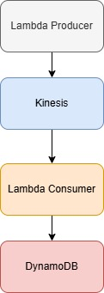
Clickstream Data
Data Generation A producer Lambda function generates real-time clickstream data from the e-commerce platform.
Streaming Pipeline The generated data is streamed to AWS Kinesis, enabling real-time processing.
Data Processing A consumer Lambda function, linked to the Kinesis stream, processes the data.
Data Storage Processed data is securely stored in Amazon DynamoDB for historical analysis and integration with business systems.

Slide 4
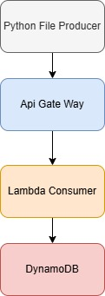
IoT Sensor Data
IoT Data Generation Sensors installed on delivery trucks generate real-time data, such as GPS location, speed, fuel consumption, and engine diagnostics.
API Gateway The IoT sensor data is sent to an API Gateway, which securely ingests and manages the incoming data.
Lambda Consumer A Lambda function processes the telemetry data, applying logic to extract insights and transform the data as needed.
Data Storage in DynamoDB The processed data is stored in Amazon DynamoDB using a Slowly Changing Dimensions (SCD) Type 2 schema, ensuring historical records are preserved.

Slide 5
Thank you

